Slide 1
Introduction to Financial Aid
Amira Carswell
Assistant Director, Outreach and Education
Student Financial Aid
The University of Akron

Slide 2
What is Financial Aid?
Financial Aid is a broad group of funding sources that assists students in meeting the cost of attending college and can include grants, scholarships, the work-study program, and student loans.

Slide 3
Types of Financial Aid
Gift Aid | Description
Grants | Awarded by federal and state government
Scholarships | Awarded by a variety of sources including the University, community groups, businesses, etc.
Self-Help Aid | Description
Student Employment/Federal Work Study | Money earned while working part-time on campus
Subsidized/Unsubsidized Loans (student) | Low interest loans, repaid by the student after graduation
Parent Loans (PLUS) | Loans that parents borrow, repaid by the parent after graduation or while the student is in school
Private Loans | Loans that students borrow (often needs a cosigner), repaid after graduation
Payment Plans/529 College Savings | Some institutions offer payment/installment plans or families may have college savings plans to assist with costs.

Slide 4
Federal Aid
Grants (free money)
Federal Pell Grant
Supplemental Educational Opportunity Grant (SEOG)
TEACH Grant
Federal Work-Study
Part-time employment opportunities for students with financial need. Funds earned are paid directly to the student for educational expenses.

Slide 5
State Aid
The Ohio Department of Higher Education
Ohio War Orphans Scholarship
Ohio Safety Officers College Memorial Fund
Ohio College Opportunity Grant
www.ohiohighered.org

Slide 6
Scholarships
Universities and Colleges
High school counselors
Private foundations, businesses, charitable organizations
Civic organizations, employers, credit unions
Scholarship sites
- www.fastweb.com
- www.scholarships.com
- www.collegenowgc.org

Slide 7
Federal Direct Student Loans
Subsidized Direct Loan
Unsubsidized Direct Loan
Interest free during periods of at least half-time enrollment
Six-month grace period before repayment begins
Current interest rate when repayment begins is 6.53%
Student is the borrower and begins repaying after graduating or leaving college.
Accrues interest during periods of enrollment
Six-month grace period before repayment begins
Current interest rate is 6.53% and begins immediately
Student is the borrower and begins repaying after graduating or leaving college.

Slide 8
Parent Loans
Parent Loan for Undergraduate Students (PLUS)
Parent is the borrower—not the student
Current Interest rate is 9.08%
Interest begins accruing as funds are disbursed
May choose to defer payments while student is in school
May have remaining funds (after school charges are paid) sent to the student for other educational expenses (books, supplies, transportation, etc.)
Credit-based, may use an endorser if initially denied
If parent is ineligible, student will have additional eligibility from the Unsubsidized Direct Loan

Slide 9
How Do I Apply for Financial Aid?
The Free Application for Federal Student Aid (FAFSA) at www.studentaid.gov
This application is used for federal and state grants, federal work-study, federal student and parent loans.
The FAFSA is anticipated to be available December 1, 2024

Slide 10
Important FAFSA Notes
Tax information will be loaded directly from your federal income tax return from 2023.
All contributors will be required to give consent for their tax information to be imported into the FAFSA.
Students can list up to 20 school choices to receive their FAFSA results.
Students whose parents are divorced, will report the income for the parent (and stepparent if remarried) who provided the majority financial support, NOT the parent that they lived with for the past twelve months unless that parent provided the majority financial support.

Slide 11
Student Aid Index (SAI)
The Student Aid Index (SAI) is determined by the FAFSA
The federal methodology is applied to information reported on the FAFSA to determine this index number.
The SAI determines grant eligibility and financial need.
Financial Need is:
Cost of Attendance
– SAI
– Other Financial Assistance (OFA)
= Financial Need
Financial need is used to determine student loan eligibility, parent loans, federal work study, and some scholarships.

Slide 12
Everyone Needs an FSA ID!
This will serve as your legal signature on federal financial aid documents and the FAFSA.
Go to www.studentaid.gov.
Click on Create Account and review the information about what you can do with your account and what you need.
Click on Get Started and create your account.
You will need a permanent email, mobile-phone number, and social security number.
Create your FSA ID NOW, don’t wait.

Slide 13
Application Process
Start
Complete the FAFSA
Government Processes Application
School receives FAFSA results
School requests any additional documents needed
Financial Aid Offer!
School determines awards
You submit documents

Slide 14
Financial Aid Offer
Schools will likely begin sending financial aid offer letters in approximately March.
Will arrive either by U.S. Mail to the student’s home or email to the student’s college or university assigned email address.
Award notifications are sent to students, not parents.
Offer will include estimated costs and all types of financial aid being offered to the student for the year (at that time).

Slide 15
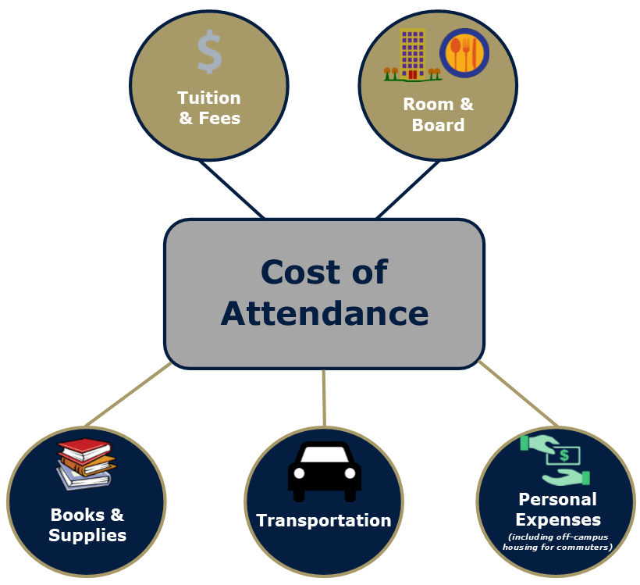

Slide 16
Sample Costs
Private Four-Year University
Tuition and Fees $38,832
Room and Board $13,774
Total $52,606
Public Four-Year University
Tuition and Fees $13,346
Room and Board $11,904
Total $25,250
Community College
Tuition and Fees $7,916

Slide 17
What if I don’t receive enough aid?
Payment Plans
529 College Savings Plans
Private Educational Loans
Employment
Appeal for a special circumstance such as a loss of income or job.

Slide 18
REMINDERS
Don’t pay to file the FAFSA or for scholarship info!
Read everything sent to you by the financial aid office.
Turn in requested documents in a timely manner.
Finalize everything by JUNE
Call the financial aid office if you have any questions.

